Slide 1
MIT-ORC Model Test Results
Yuqi Zhang 07/22/2020

Slide 2
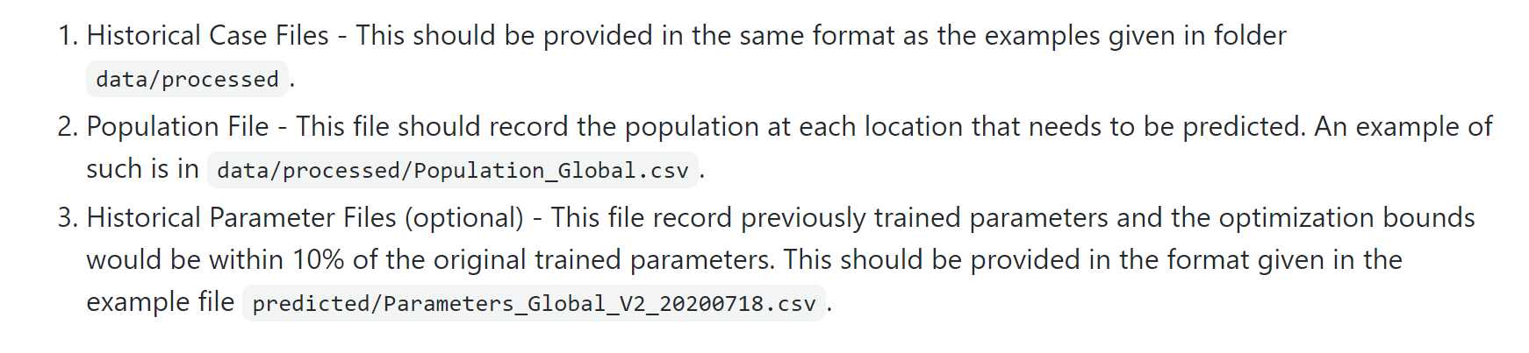
Brief Summary of MIT-ORC Model
SEIR Model
Predictions:
Total Detected; Active Cases; Active Hospitalized; Cumulative Hospitalized; Total Detected Deaths; Active Ventilated
Global, US, US States
There was an update from V2 to V3 (in use since 07/04)
Data Usage:
I obtained historical parameters files from 04/03 to 07/18 from the team
Policy Information (V3 only): Lock Down; Restrict Mass Gatherings and Schools

Slide 3
Reproducibility
If we don’t use historical parameters, the results will be quite different from the team’s results, particularly for regions that are still in “increasing” stages
“Gaps” in the Projection: They made extra adjustments
 |  | Results From the Team |  | Results Produced by Yuqi |  | △ = MIT's - Yuqi's
Region | Date | Cum Cases | Cum Deaths | Cum Cases | Cum Deaths | △ Cum Cases | △ Cum Deaths
California | 7/19/2020 | 400157 | 9205 | 401824 | 9158 | -1667 | 47
California | 7/20/2020 | 408900 | 9363 | 410721 | 9316 | -1821 | 47
California | 7/21/2020 | 417682 | 9521 | 419664 | 9475 | -1982 | 46
California | 7/22/2020 | 426503 | 9680 | 428651 | 9634 | -2148 | 46
California | 7/23/2020 | 435360 | 9838 | 437678 | 9794 | -2318 | 44
California | 7/24/2020 | 444252 | 9996 | 446746 | 9953 | -2494 | 43
California | 7/25/2020 | 453176 | 10155 | 455851 | 10113 | -2675 | 42
California | 8/2/2020 | 525513 | 11424 | 529822 | 11395 | -4309 | 29
California | 8/9/2020 | 589618 | 12526 | 595628 | 12512 | -6010 | 14
California | 8/16/2020 | 653744 | 13609 | 661693 | 13615 | -7949 | -6

Slide 4
Validation Details
For 7 regions that we already seen “peak”, we run projection on peak date, 2wks before peak, 1wk before peak, 1wk after peak, 2wks after peak
For 5 regions in which daily deaths are still increasing, we run projection on 1wk before, 2wks before and 4wks before
Projections are validated till July. 15th
Regarding Different Versions: Fit close to MIT team’s running senario
We used V2 w/o historical parameters for Italy, Spain, New York, Washington
V2 w/ historical parameters for Russia, Maryland, Michigan
V3 w/ historical parameters for India, Mexico, Brazil, California, Arizona

Slide 5
V2 w/o historical parameters

Slide 6
V2 w/o historical parameters

Slide 7
V2 w/ historical parameters

Slide 8
V3 w/ historical parameters

Slide 9
V3 w/ historical parameters

Slide 10
V3 w/ historical parameters

Slide 12
Model Names | Method | Intervention assumptions | Code Availability | Results | Prediction Region | Prediction Type | Language
Auquan | SEIR | No Assumptions | https://www.kaggle.com/davidadavid/how-we-built-a-covid-19-model-used-by-the-cdc/comments | Web App | State; National; Global | Deaths & Cases | Python
Columbia | Metapopulation SEIR | Contact rates will increase 5% per week over the next two weeks. The reproductive number is then set to 1 for the remaining period. | ? | Web App / Tables | County; State; National | Deaths & Cases; ICU Bed Demand; Hospital Bed Demand; Ventilator Demand; Infection Rate | NA
CAN | SEIR | A 20% increase in mobility as each state reopens | https://github.com/covid-projections/covid-data-model | Web App / Tables | State | Deaths; ICU Bed Demand; Hospital Bed Demand; Infection Rate | Python
Covid19Sim | SEIR | Once stay-at-home orders are lifted, contact rates will gradually increase. Households containing symptomatic cases will self-quarantine. | ? | Web App | State; National | Deaths & Cases; ICU Bed Demand; Hospital Bed Demand | NA
GT-DeepCOVID | Deep Learning | The effects of interventions are reflected in the observed data and will continue going forward. | ? | Images | State; National | Deaths | NA
IHME | Combination of a mechanistic disease transmission model and a curve-fitting approach. | Projections are adjusted to reflect differences in aggregate population mobility and community mitigation policies. | https://github.com/ihmeuw-msca/CurveFit | Web App | State; National; Global | Deaths & Cases; ICU Bed Demand; Hospital Bed Demand; Ventialator Demand; Social Distancing | Python
35 Models in Total Now

